Slide 1
Parent Forum

Slide 2
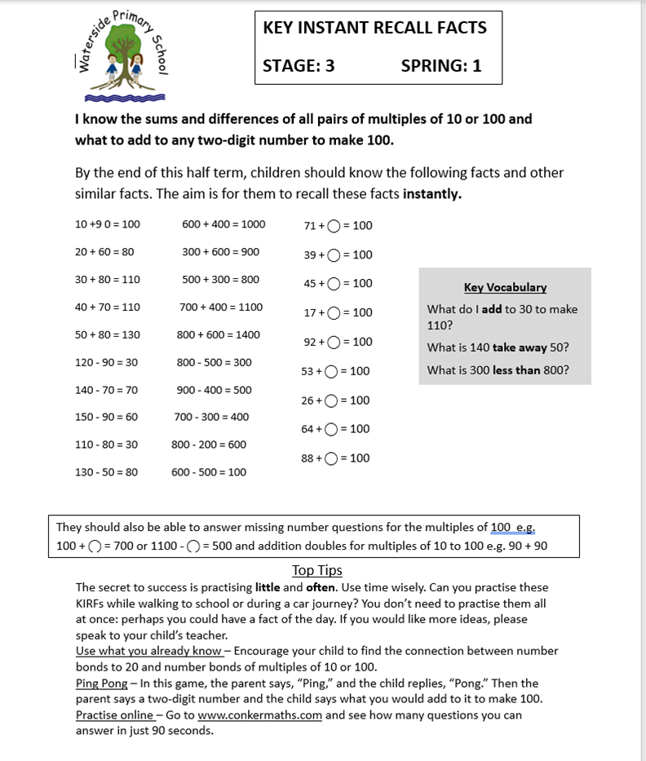
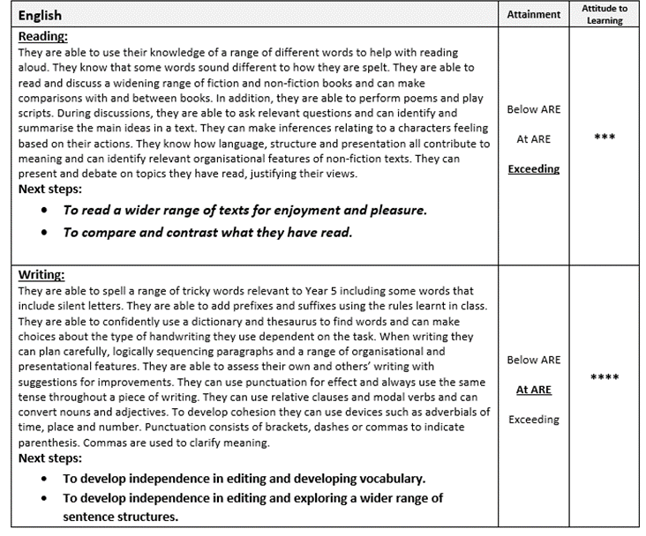
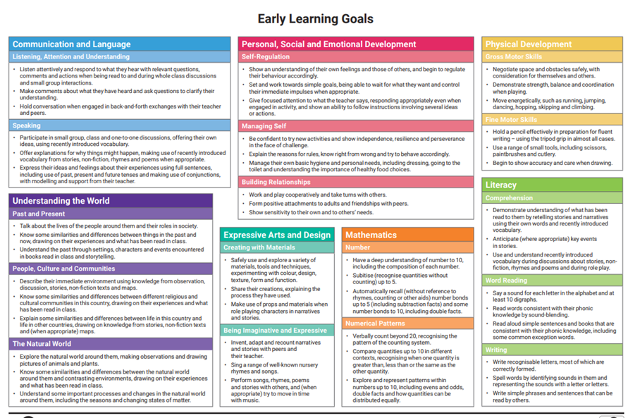
Current Topic
How do parents know what ARE looks like/ what is expected of their child?:
Reports to parents of attainment
Information evenings
Kirfs
Conversations with teachers/ children
Parent Sharing events

Slide 5
WE ASKED: Do you have ideas for more useful tools in sharing with parents?
YOU SAID:
Possibly digital PDF downloads for ease of printing, responses collected with google forms/jot form, quick and easy to respond in the moment.
Overall I am happy with what is offered.
PDFs to be added to class blogs on new website
Using the children and video to share what learning expectations look like – to be shared again in class blogs

